Slide 1
MATERIAL REVIEW Session 25&26
Course : ISYS6280 – Database Systems (GAT)
Year : 2015

Slide 2
LEARNING OUTCOME
LO 1: Describe database systems, terminology, environment, and new concept of database

Slide 3
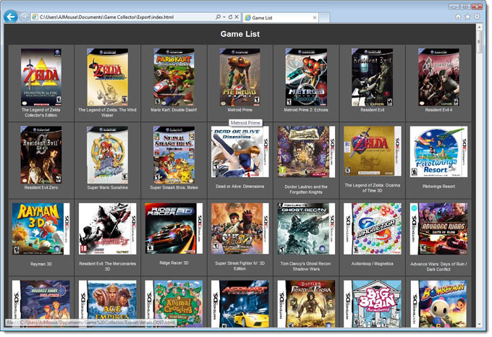
Game Development Database
In develop game Database, database designer must concern on how the game work
In running the game also concern what kind of data and information that must be store in database
Database designer can start from make Class Diagram before convert to ER Modeling which can identify the entities in game database
www.collectorz.com

Slide 4
User Interface Design for Game
INPUT
How the Players communicate their chosen actions to the game
OUTPUT
How the Game displays the results of those actions to the Players
http://www.slideshare.net/marlin_andi/session-6-creating-user-interface-your-game

Slide 5
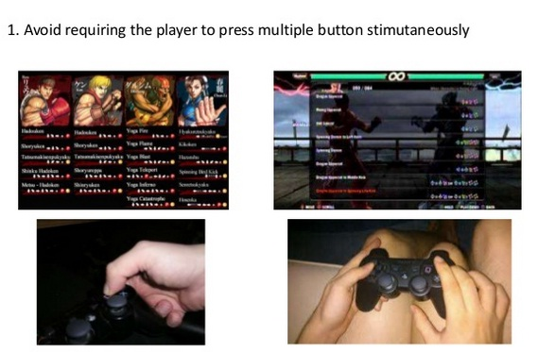
User Interface Design for Game
Accessibility
http://www.slideshare.net/marlin_andi/session-6-creating-user-interface-your-game

Slide 6
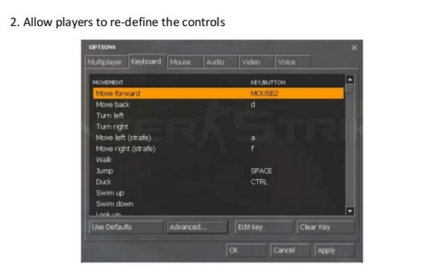
User Interface Design for Game
Accessibility
http://www.slideshare.net/marlin_andi/session-6-creating-user-interface-your-game

Slide 7
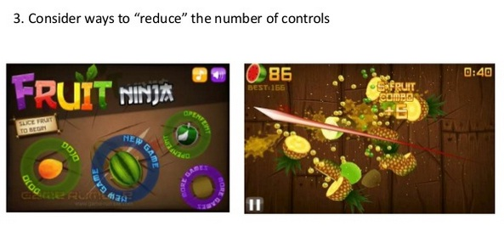
User Interface Design for Game
Accessibility
http://www.slideshare.net/marlin_andi/session-6-creating-user-interface-your-game

Slide 8
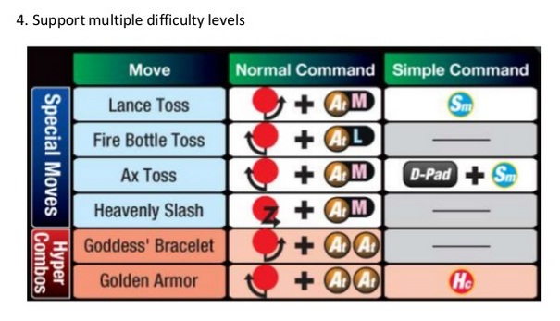
User Interface Design for Game
Accessibility
http://www.slideshare.net/marlin_andi/session-6-creating-user-interface-your-game

Slide 9
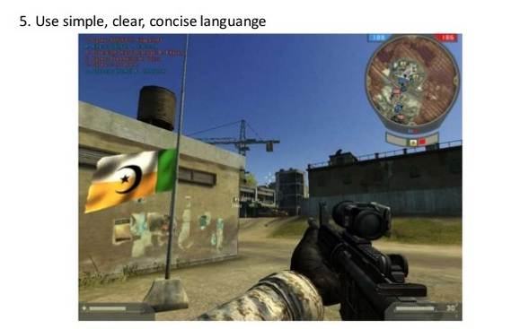
User Interface Design for Game
Accessibility
http://www.slideshare.net/marlin_andi/session-6-creating-user-interface-your-game

Slide 10
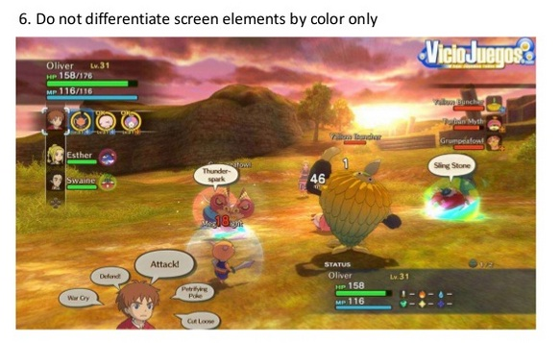
User Interface Design for Game
Accessibility
http://www.slideshare.net/marlin_andi/session-6-creating-user-interface-your-game

Slide 11
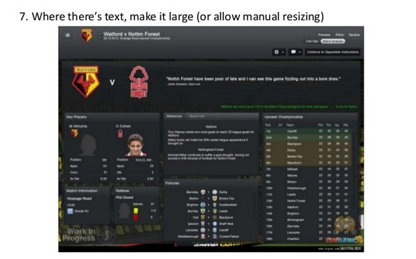
User Interface Design for Game
Accessibility
http://www.slideshare.net/marlin_andi/session-6-creating-user-interface-your-game

Slide 12
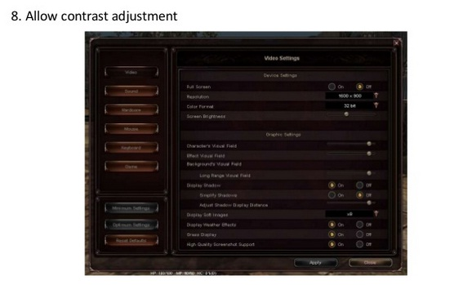
User Interface Design for Game
Accessibility
http://www.slideshare.net/marlin_andi/session-6-creating-user-interface-your-game

Slide 13
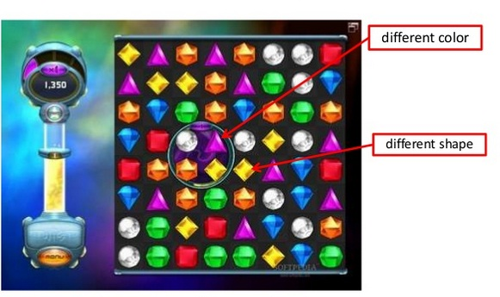
User Interface Design for Game
Accessibility
http://www.slideshare.net/marlin_andi/session-6-creating-user-interface-your-game

Slide 14
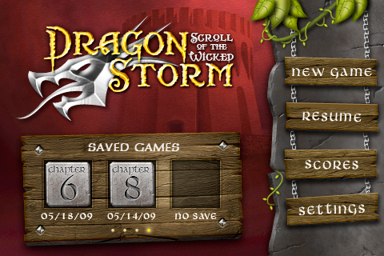
User Interface Example
design.tutsplus.com

Slide 15

User Interface Example
platinumgames.com

Slide 16

Bad User Interface
The information is unclear and confusing
http://www.neogaf.com/forum/showthread.php?t=502833

Slide 17
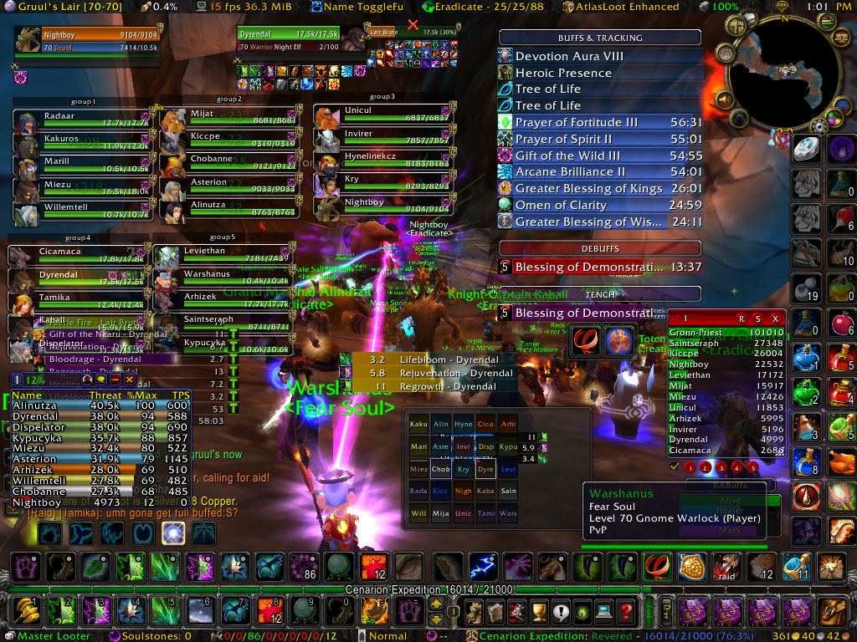
Bad User Interface
Too many words and colors
http://www.slideshare.net/marlin_andi/session-6-creating-user-interface-your-game

Slide 18
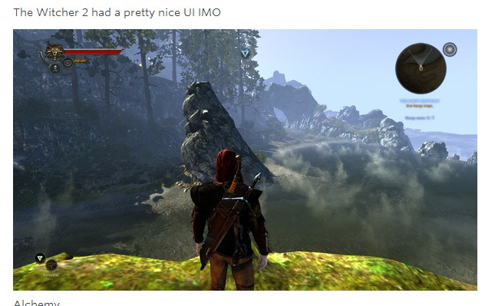
Good User Interface
https://www.designernews.co/stories/17543-ask-dn-what-video-games-have-the-best-ui

Slide 19
Review : Case Study
Please define the entity relation diagram for following game:
Monopoly
Players roll two dice and work their piece around a board, buying properties as they go, in an attempt to create monopolies with like properties. Players who land on properties another player owns must pay rent, which varies depending on the value of the property and whether players have opted to build houses and/or hotels. As players begin to go bankrupt due to rent and fees they can't afford to pay to other players, the last player standing wins.

Slide 20
Review : Case Study
Game Play Overview:
Roll the dice and advance
Managing your property purchases
Travel around the board
Buy or trade properties with another player to achieve a complete set.
Add houses and hotels.
Pay money to the bank or rent to another player
Mortgage your properties to the bank
Land on a property space, you can buy it from the bank for the price listed on the space, if it is un-owned.
Pay rent on an owned space

Slide 21
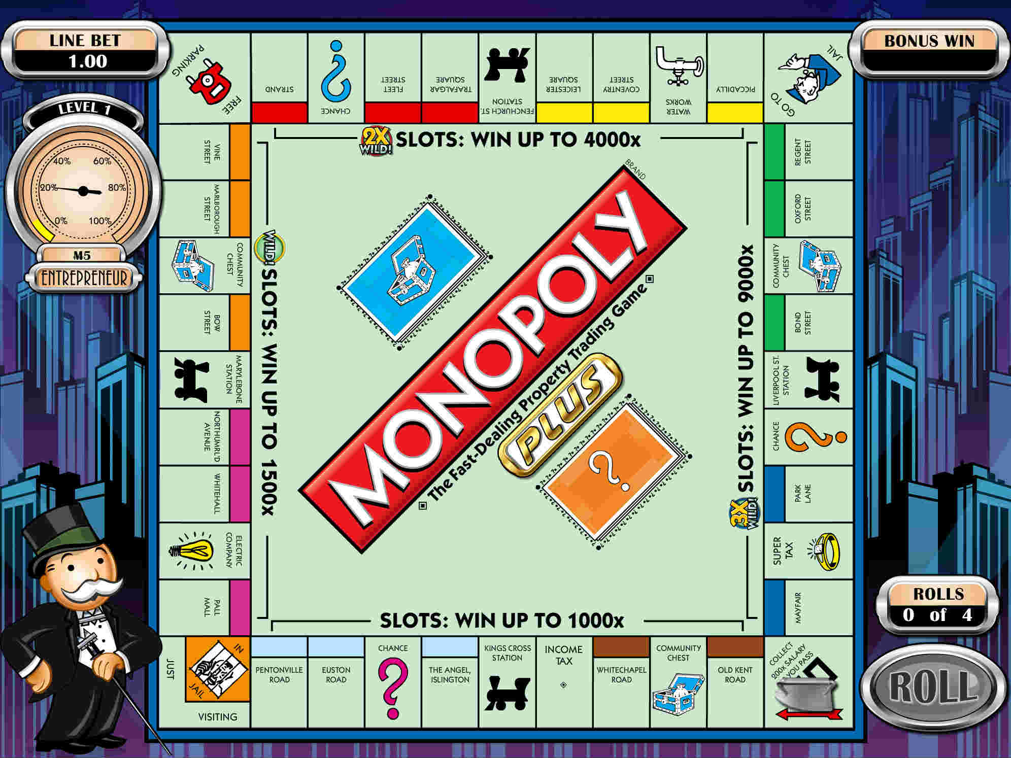
Review : Case Study
Player can speed through the play of computerized opponents, making the game extremely quick in terms of what you have to watch the computer do while giving the player all the time necessary to carefully think about their own moves. When it's the players turn, they are free to pull up the trade screen and attempt to make a deal with another player. The rules sets are completely customizable so player luxury taxes can be higher or you can play with more houses and so on and so forth.

Slide 22
Review : Case Study
Selections for house rules:
Free Parking cash
A very common house rule is to have a kitty of cash based at the Free Parking space (or in the center of the board, since there is more room there). A player who lands on Free Parking collects the cash, and the kitty is restarted. The kitty may be built in several different ways, for example:
by sending Jail fines to the kitty
by paying the fines and taxes on the Community Chest and Chance cards into the kitty rather than to the bank
by placing a predetermined amount of money from the bank into the kitty at the beginning of the game and whenever it is emptied (for example, a $500 bill, the largest currency amount in the game)
by requiring every player who passes Free Parking without landing on it to pay in a specified amount

Slide 23
Review : Case Study
Selections for house rules:
by paying income and luxury tax/super tax to the kitty
$500 is put in the kitty at the start and the first lucky person to land on it gets the $500 and the other money. After that, $500 is not put in there every time it is emptied.
The final not bought property into the kitty as soon as the penultimate property has been purchased, and it must be won by whoever lands on Free Parking. Any player who lands on the property in question while it is in the kitty may not buy it. One variation of this is to have players pay the base rent price for landing on that property into the kitty to ensure a larger reward for whoever lands on Free Parking

Slide 24
Review : Case Study
Selections for house rules:
2. Go and movement
Award a player $300, $400, or some other bonus for landing exactly on Go, instead of the $200 specified by the official rules.
A player must either completely travel around the board (having collected $200 by passing Go) or roll the dice a certain number of times before he is allowed to purchase property - landing on a property or station space has no effect during that time, while other squares function as normal.
No players may purchase property before all players have passed go at least 5 times.
No players may purchase property until ONE player has passed go. This rule is similar to the one above but makes the game go a little faster. This rule and the one above are good with games with 5 or more players.

Slide 25
Review : Case Study
Selections for house rules:
Players are allowed to "take a chance" when they land on a Chance square. They have the option 1) to draw a chance card, or 2) to do nothing and sit freely on the square. No choice is given, however, when landing on a Community Chest square; the player must draw a card from the appropriate deck.
If a player lands directly on Go, he or she has the right to not collect their $200 and instead move their game piece to any place on the board.

Slide 26
Review : Case Study
Selections for house rules:
Snake-Eyes
When someone rolls two ones (or move two spaces) they get five of each bill from the bank (five $500, five $100, five $50, five $20, five $10, five $5, and five $1 notes; if you make $1000 bills, add five $1000) for a total of $3430(with $1000 is $8430). An alternative version gives a player $1000 for rolling two ones.
Rents and auctions
Disqualifying an owner from collecting rent while in jail. This allows reprieve for other players landing on an expensive property with houses or a hotel during the time a player is incarcerated.
When a player lands on an unowned property and elects not to purchase it the property remains unowned, rather than being auctioned among the other players.
5. Mercy Rule
When a player reaches a certain level of wealth they automatically win

Slide 27
Review : Case Study
Selections for house rules:
Property improvements
Exclude the requirement of owning all properties of the same color before being able to buy houses.
Allow a player to build a hotel directly; even if there are not enough houses in the bank (one hotel equals five houses).
Allow players to build on a certain property only when they land on it.
Other short games (unofficial rules)
Shorten the game is to play for a predetermined amount of time. When the time limit is reached, the winner is the one with the greatest assets in cash, property, and houses.
Randomly distribute a predetermined number of property cards before the start of the game.
Play until all have gone around the board a certain number of times.

Slide 28

www.healthytravelblog.com

